Slide 1

ABC CALL VOLUME TREND ANALYSIS
FINAL PROJECT - 4
~ ARYAN AUDITTO

Slide 2
CALL VOLUME TREND ANALYSIS WORKING FILE
HYPERLINK FOR THE WORKING FILE : Call_volume_trend_analysis
NOTE: All the tasks are shown in this working file and each task is separated into different sheets

Slide 3
01
PROJECT DESCRIPTION
The objective of this project is to analyze the inbound call data of an insurance company (ABC Company) and derive insights to improve their call center operations. we are providing you with a dataset of a Customer Experience (CX) Inbound calling team for 23 days. Data includes Agent_Name, Agent_ID, Queue_Time [duration for which customer have to wait before they get connected to an agent], Time [time at which call was made by customer in a day], Time_Bucket [for easiness we have also provided you with the time bucket], Duration [duration for which a customer and executives are on call, Call_Seconds [for simplicity we have also converted those time into seconds], call status (Abandon, answered, transferred). The project aims to calculate the average call time duration, visualize the volume of calls over time, propose a manpower plan to reduce the abandon rate, and address the issue of unanswered calls during the night. The project will provide recommendations based on the analysis to enhance customer experience and optimize resource allocation.
02
APPROACH
The provided dataset was cleaned and preprocessed to ensure accurate analysis. This involved handling missing values, formatting time data, and transforming the dataset into a suitable format for analysis.
Average Call Time Duration: The dataset was analyzed to calculate the average call time duration for each time bucket, providing insights into the efficiency of call handling.
The number of calls was aggregated based on time buckets and visualized using charts/graphs to identify any patterns or trends in call volume over time.
Using the current abandon rate and the desired target abandon rate, a manpower plan was formulated to determine the minimum number of agents required in each time bucket.

Slide 4
By considering the current abandon rate and the desired target abandon rate, the project proposed a manpower plan that determined the minimum number of agents required in each time bucket.
The project addressed the issue of unanswered calls during the night by proposing a manpower plan to allocate agents for handling these calls.
03
TECH - STACK USED
I used Microsoft Excel as the primary tool for data analysis and dashboard creation due to its versatility and ease of use for data manipulation, analysis, and visualization.
04
INSIGHTS

Slide 5
Average Call Time Duration :
Average of call time duration answered by the agents came around 198.622 Seconds.
Majority of the calls answered by agents came in time bucket 19-20 ( 7pm to 8pm) followed by 10-11 (10am to 11 am)
Least amount of calls attended by agents came in between 12pm to 1pm.
Volume of Calls Analysis :
Plotted pivot table consisting of time_bucket, Customer_phone_No and Time.
Majority of the customers call in between 11am to 12pm followed by 10am to 11am.
Least amount of customers call in recognized in time bucket 20-21 i.e. 8pm to 9pm.
This information can be used to optimize staffing levels and ensure adequate agent availability during busy periods.
Manpower Plan Proposal :
Plotted pivot table consisting of Date & Time, Call status and Call Duration.
According to the assumptions, an agent’s total working hours is around 9hrs.Excluding lunch and snack break which is around 1.5hrs, agent works around 60% of 7.5 hrs which is around 4.5 hrs actual working hours.
Determined the total call seconds which is 676664 second. Further converted it into hours by dividing total call seconds by 3600 i.e. 187.962 hours. Further determined total number of agents.
Agents required to maintain 90% of calls to be answered per day is around 62. Further divided the agents in each time bucket

Slide 6
Handling Night Calls :
Determined the time distribution from given call distribution by dividing each call distribution by total call distribution.
Majority of the night shift calls are made around 8am to 9am, followed by 9-10,10-11 etc.
Agents required for night shift calls i.e from 9pm to 9am was determined around 17 agents and further divided the agents in each time bucket.
05
RESULTS

Slide 7
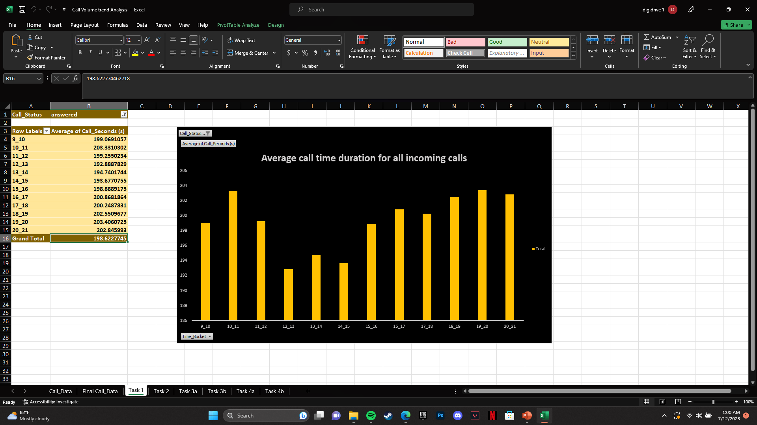
TASK 1 : Calculate the average call time duration for all incoming calls received by agents (in each Time_Bucket).

Slide 8
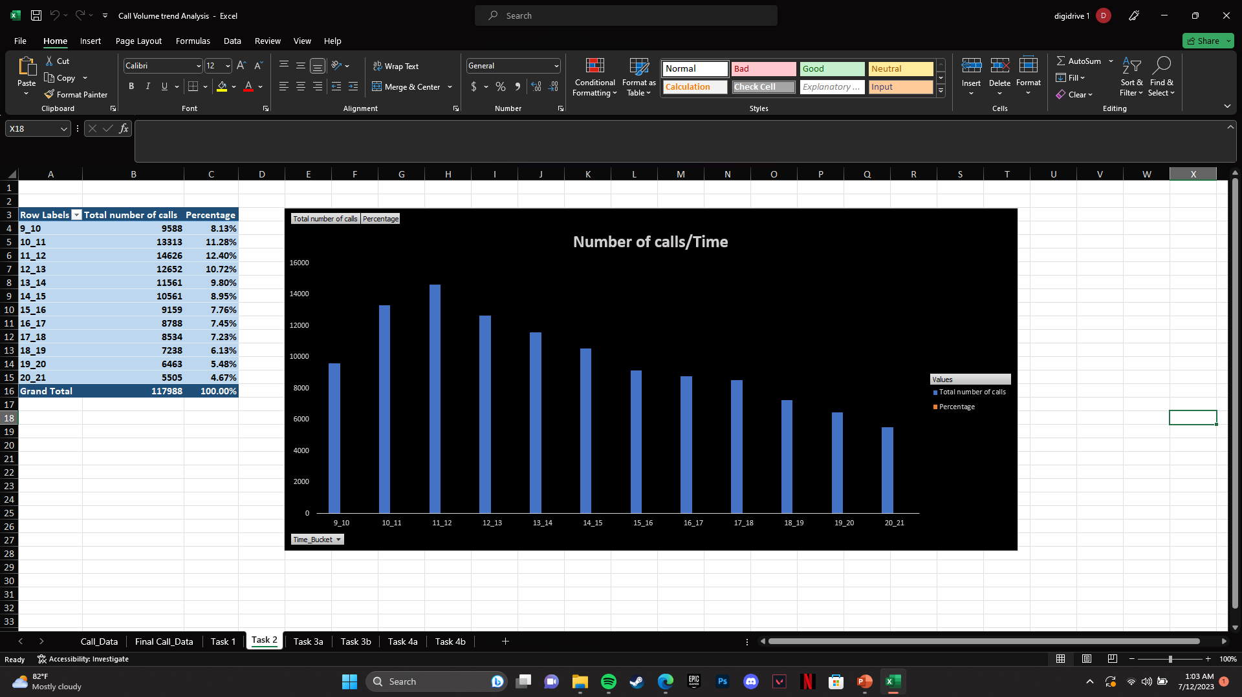
TASK 2 : Show the total volume/ number of calls coming in via charts/ graphs [Number of calls v/s Time]. You can select time in a bucket form (i.e. 1-2, 2-3, …..)

Slide 9
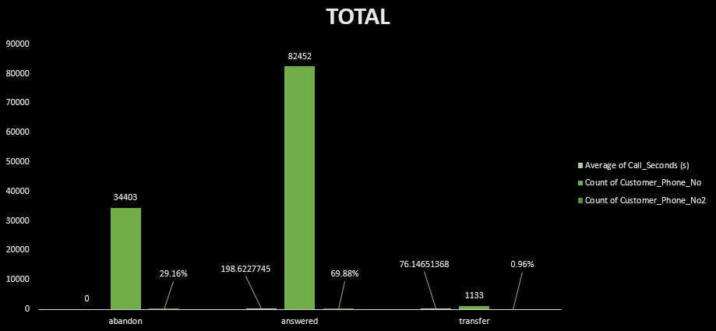
TASK 3 : As you can see current abandon rate is approximately 30%. Propose a manpower plan required during each time bucket [between 9am to 9pm] to reduce the abandon rate to 10%. (i.e. You have to calculate minimum number of agents required in each time bucket so that at least 90 calls should be answered out of 100.)

Slide 10
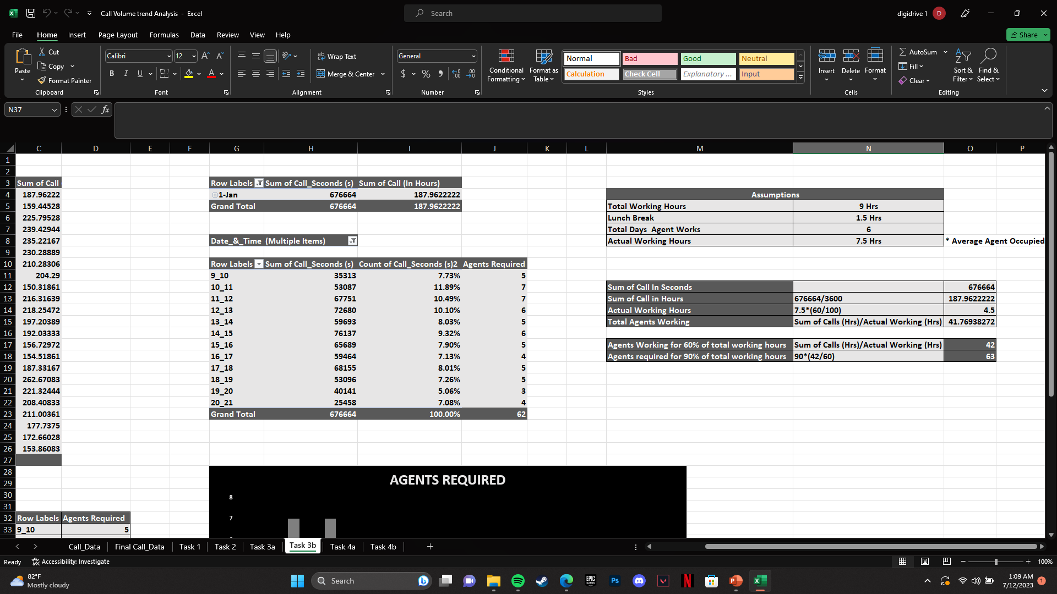
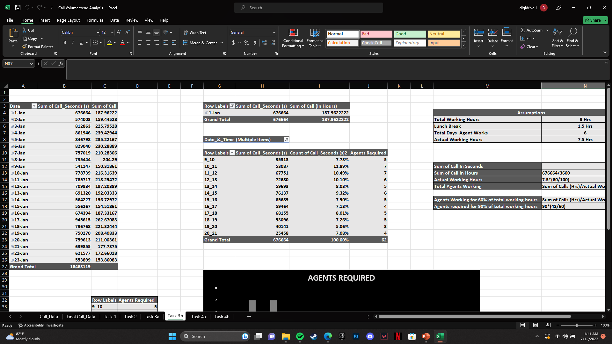
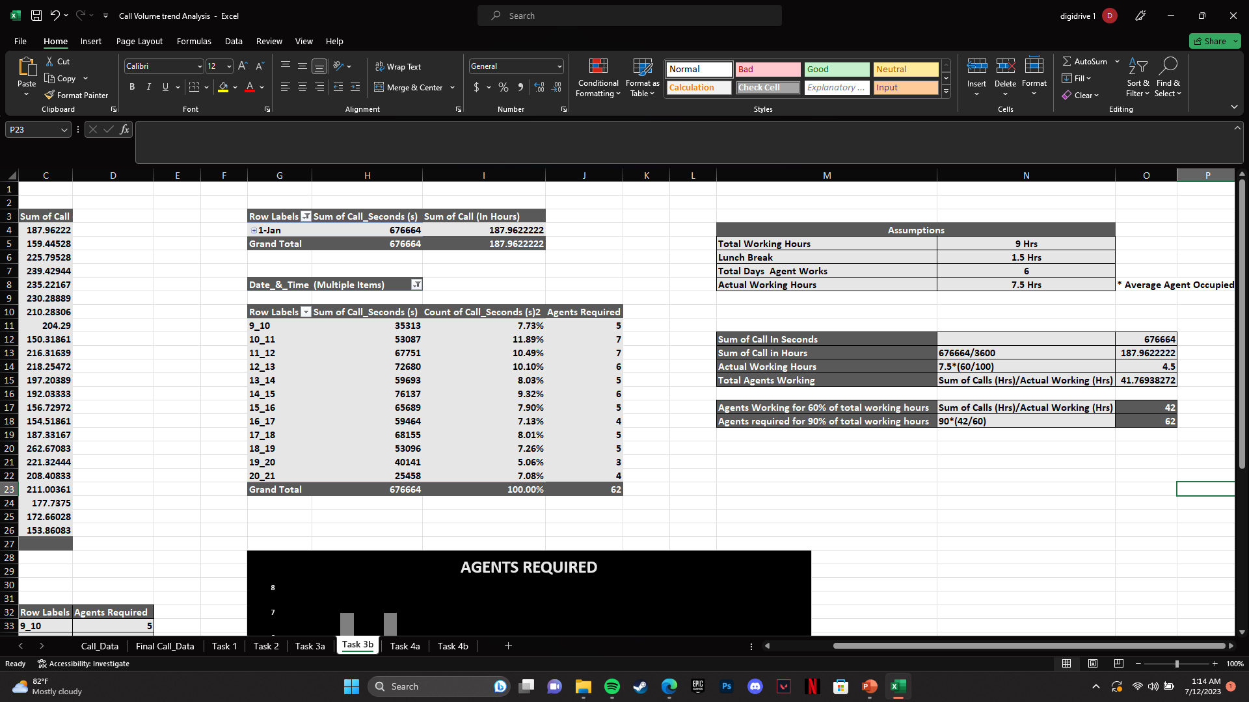
Sum of call in seconds =676664
Sum of call in hours = 676664/3600 = 187.9622222
Actual Working hours = 7.5 hrs *(60/100) = 4.5 hrs
To determine the total agents working,
Total Agents working = Sum of Calls(hrs)/Actual Working hours
= 187.9622222/4.5 = 41.76938272 ~ 42
Agents Working for 60% of total working hours = 42
To determine number of agents for 905 of total working hours, using Utinary method :
Agents Working for 90% of total Working hours = 90*(42/60) = 62

Slide 11
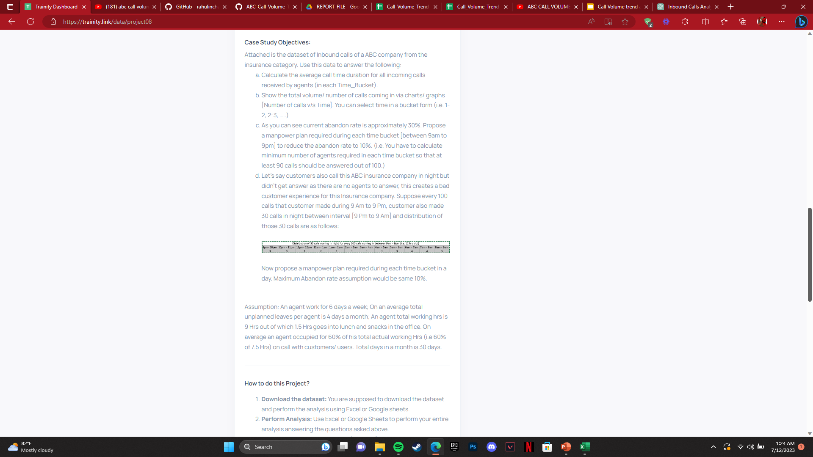
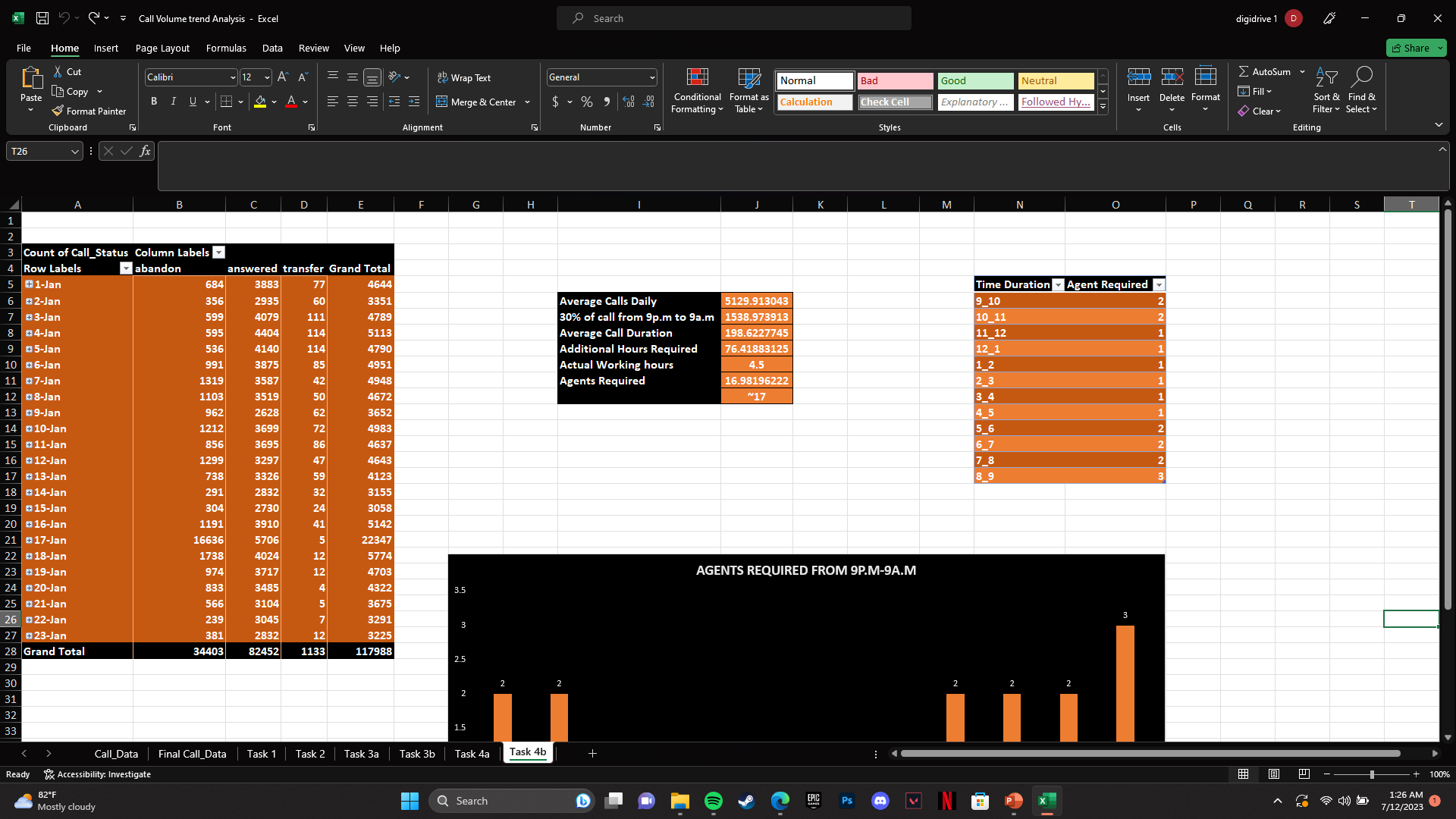
TASK 4 : Let’s say customers also call this ABC insurance company in night but didn’t get answer as there are no agents to answer, this creates a bad customer experience for this Insurance company. Suppose every 100 calls that customer made during 9 Am to 9 Pm, customer also made 30 calls in night between interval [9 Pm to 9 Am] and distribution of those 30 calls are as follows:

Slide 12
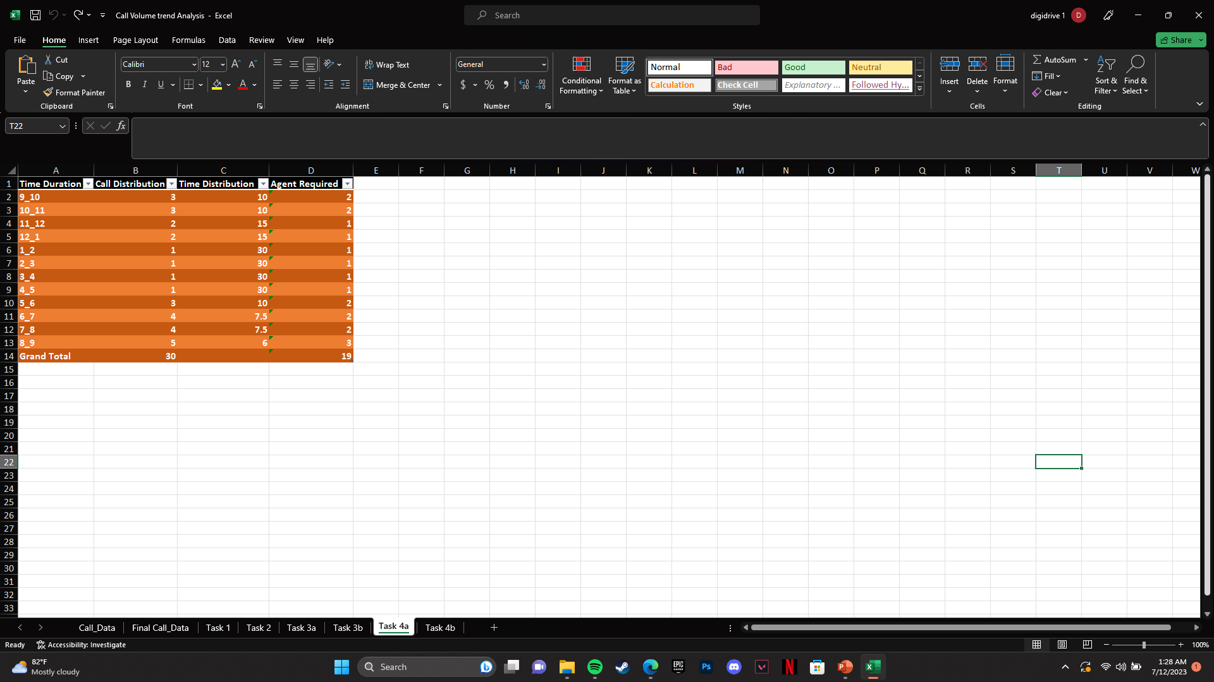
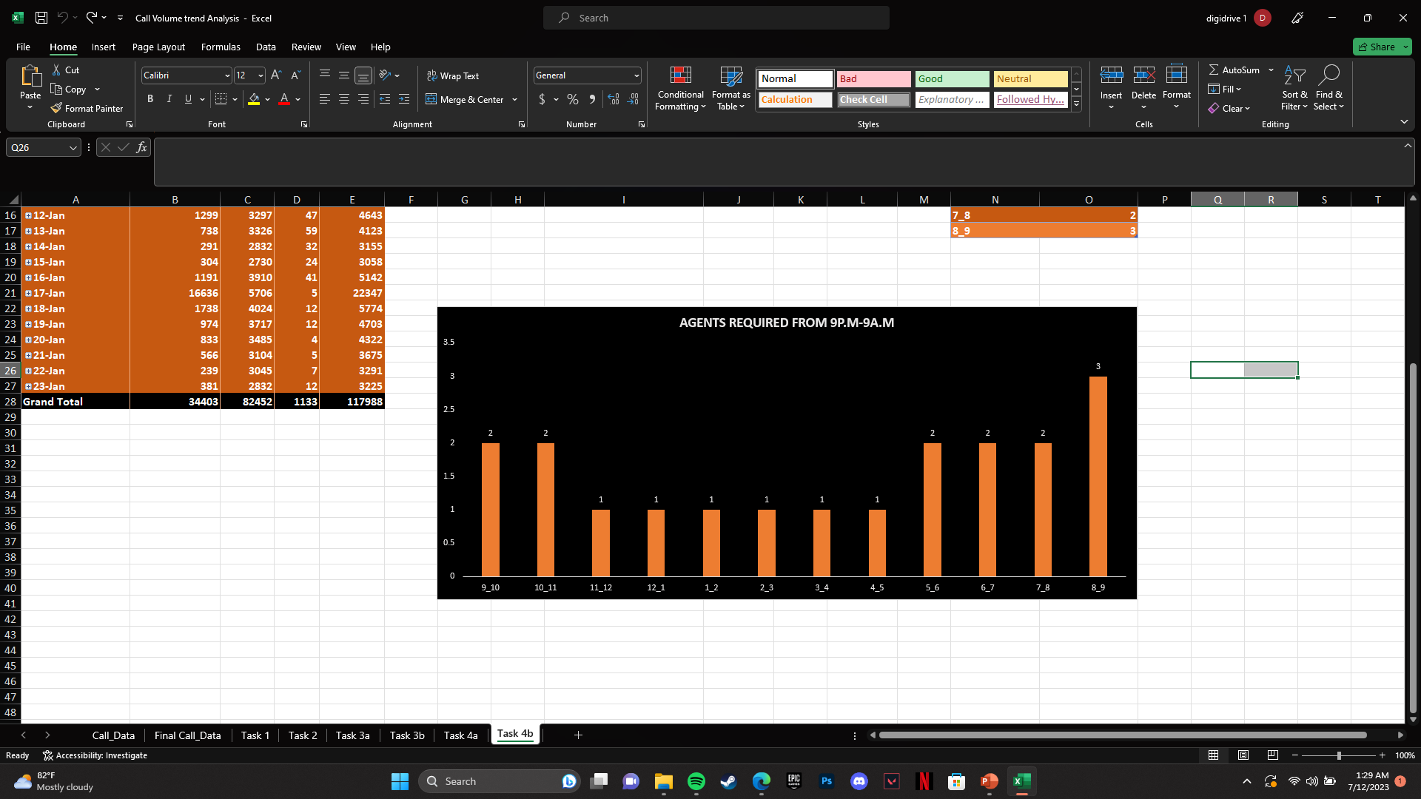

Slide 13
THANK YOU !

